Slide 1
Lectures 5-6 Roots of Nonlinear Equations
CSE 2207
Numerical Methods

Slide 2
Bisection Method
f(x)
b
a
x
f(x)=0
f(x) is real and continuous in the interval a<x<b and f(a).f(b)<0
There is at least one real root in the interval [a, b]

Slide 3
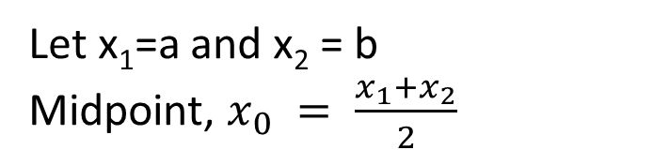
Bisection Method (cont.)
Let x₁=a and x₂ = b
Midpoint, $x_{0} = \frac{x_{1}+x_{2}}{2}$
f(x)
x_{r}
x₁=a
x₀
There exists 3 following conditions:
If f(x₀)=0, x₀ is the root
If f(x₀).f(x₁)<0, root lies in [x₀, x₁], so, x₂ replaced by x₀
If f(x₀).f(x₂)<0, root lies in [x₀, x₂], so, x₁ replaced by x₀
x₂=b
x
new x₀
f(x)=0
Repeat step 1~3, until the interval containing the root is as small as we desire.
Limitations:
Slow to converge
Requires more iteration

Slide 4
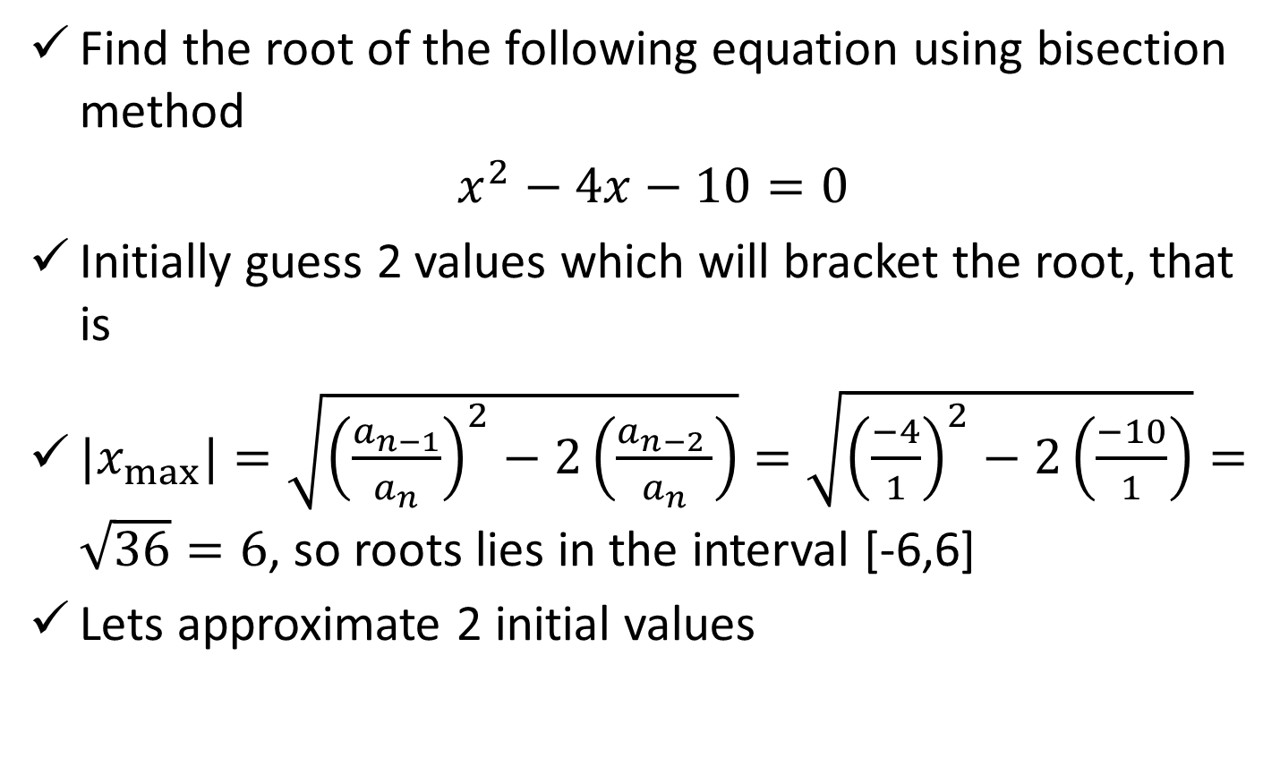
Bisection Method (cont.)
Find the root of the following equation using bisection method
$x^{2}−4x−10=0$
Initially guess 2 values which will bracket the root, that is
${|x}_{max⁡}|=\sqrt{{\left(\frac{a_{n−1}}{a_{n}}\right)}^{2}−2\left(\frac{a_{n−2 }}{a_{n}}\right)}=\sqrt{{\left(\frac{−4}{1}\right)}^{2}−2\left(\frac{−10}{1}\right)}=\sqrt{36}=6$, so roots lies in the interval [-6,6]
Lets approximate 2 initial values
Roots lie here
x
-6
-5
-4
-3
-2
-1
0
1
2
3
4
5
6
f(x)
50
35
22
11
2
-4
-10
-13
-14
-13
-10
-5
2

Slide 5
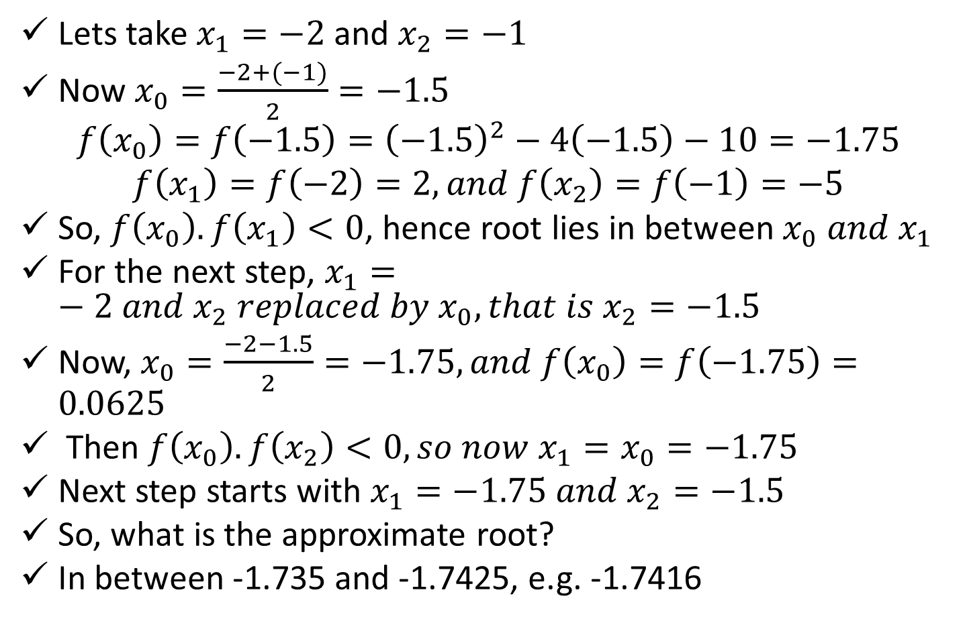
Bisection Method (cont.)
Lets take $x_{1}=−2$and $x_{2}=−1$
Now $x_{0}=\frac{−2+(−1)}{2}=−1.5$
$$f\left(x_{0}\right)=f\left(−1.5\right)={\left(−1.5\right)}^{2}−4\left(−1.5\right)−10=−1.75$$
$$f\left(x_{1}\right)=f\left(−2\right)=2, and f\left(x_{2}\right)=f\left(−1\right)=−5$$
So, $f\left(x_{0}\right).f\left(x_{1}\right)<0$, hence root lies in between $x_{0} and x_{1}$
For the next step, $x_{1}=−2 and x_{2} replaced by x_{0}, that is x_{2}=−1.5$
Now, $x_{0}=\frac{−2−1.5}{2}=−1.75, and f\left(x_{0}\right)=f\left(−1.75\right)=0.0625$
Then $f\left(x_{0}\right).f\left(x_{2}\right)<0, so now x_{1}=x_{0}=−1.75$
Next step starts with $x_{1}=−1.75 and x_{2}=−1.5$
So, what is the approximate root?
In between -1.735 and -1.7425, e.g. -1.7416

Slide 6
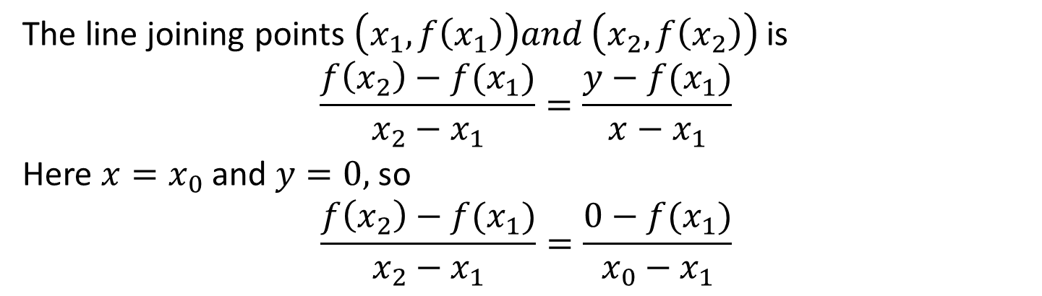
False Position Method (Linear interpolation method)
The root may be closer to the one end
The intersecting point on the x axis (x₀) provides improved estimate of root, called False position of the root
x₀ replaces x₁ or x₂ based on their functions values (similar of bisection method)
(x₀, f(x₀))
(x₂, f(x₂))
f(x)
x_{r}
x₁
x₀
x₂
x
(x₁, f(x₁))
New x₀
This process is repeated until f(x₀) value is 0 or close to 0
The line joining points $\left(x_{1}, f\left(x_{1}\right)\right)and \left(x_{2}, f\left(x_{2}\right)\right)$is
$$\frac{f\left(x_{2}\right)−f(x_{1})}{x_{2}−x_{1}}=\frac{y−f(x_{1})}{x−x_{1}}$$
Here $x=x_{0}$ and $y=0,$so
$$\frac{f\left(x_{2}\right)−f(x_{1})}{x_{2}−x_{1}}=\frac{0−f(x_{1})}{x_{0}−x_{1}}$$
Note: here one point (x₁) is fixed, other point (x₂) changes, closes to the root

Slide 7

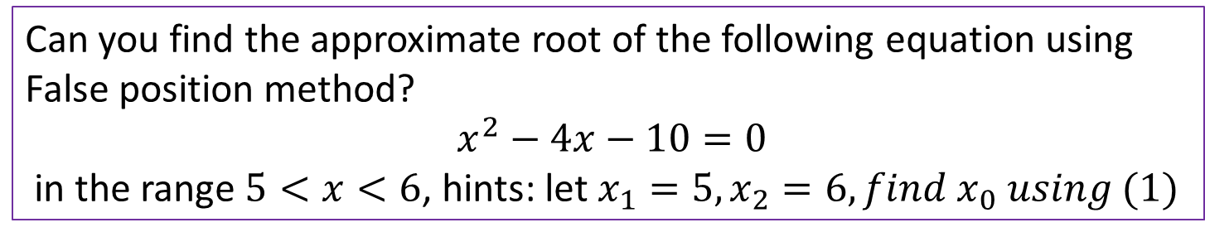
False Position Method (cont.)
$$x_{0}−x_{1}=−\frac{f(x_{1})(x_{2}−x_{1})}{f\left(x_{2}\right)−f(x_{1})}$$
So, $x_{0}=x_{1}−\frac{f\left(x_{1}\right)\left(x_{2}−x_{1}\right)}{f\left(x_{2}\right)−f\left(x_{1}\right)} (1)$
What is the difference between the Bisection and the False position method?
Can you find the approximate root of the following equation using False position method?
$x^{2}−4x−10=0$
in the range $5<x<6$, hints: let $x_{1}=5, x_{2}=6, find x_{0} using (1)$

Slide 8
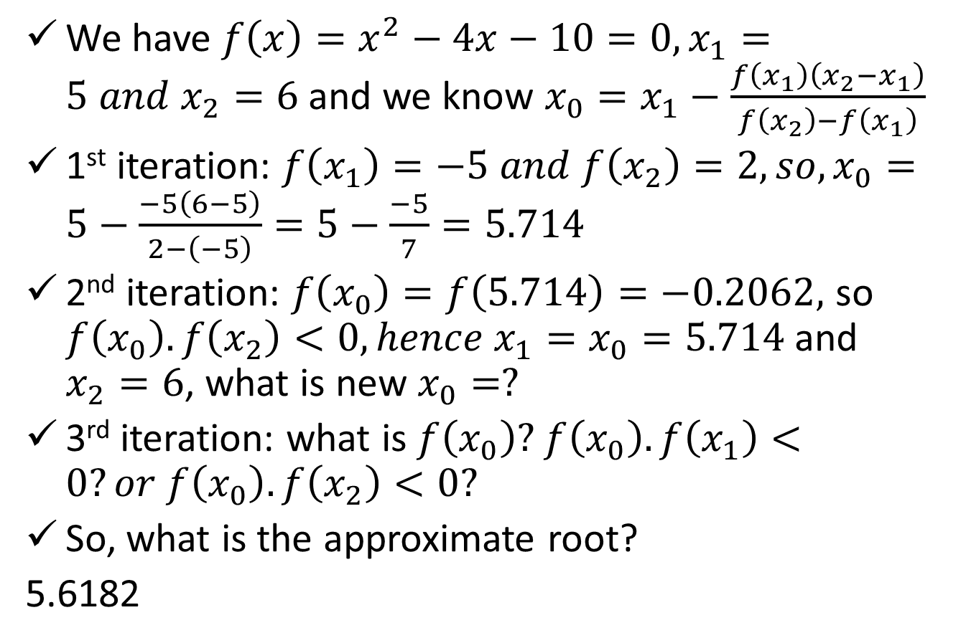
False Position Method (cont.)
We have ${f\left(x\right)=x}^{2}−4x−10=0, x_{1}=5 and x_{2}=6$ and we know $x_{0}=x_{1}−\frac{f\left(x_{1}\right)\left(x_{2}−x_{1}\right)}{f\left(x_{2}\right)−f\left(x_{1}\right)}$
1st iteration: $f\left(x_{1}\right)=−5 and f\left(x_{2}\right)=2, so, x_{0}=5−\frac{−5\left(6−5\right)}{2−\left(−5\right)}=5−\frac{−5}{7}=5.714$
2nd iteration: $f\left(x_{0}\right)=f\left(5.714\right)=−0.2062,$ so $f\left(x_{0}\right).f\left(x_{2}\right)<0, hence x_{1}=x_{0}=5.714$and $x_{2}=6$, what is new $x_{0}=?$
3rd iteration: what is $f\left(x_{0}\right)?$ $f\left(x_{0}\right).f\left(x_{1}\right)<0?or f\left(x_{0}\right).f\left(x_{2}\right)<0?$
So, what is the approximate root?
5.6182

Slide 9
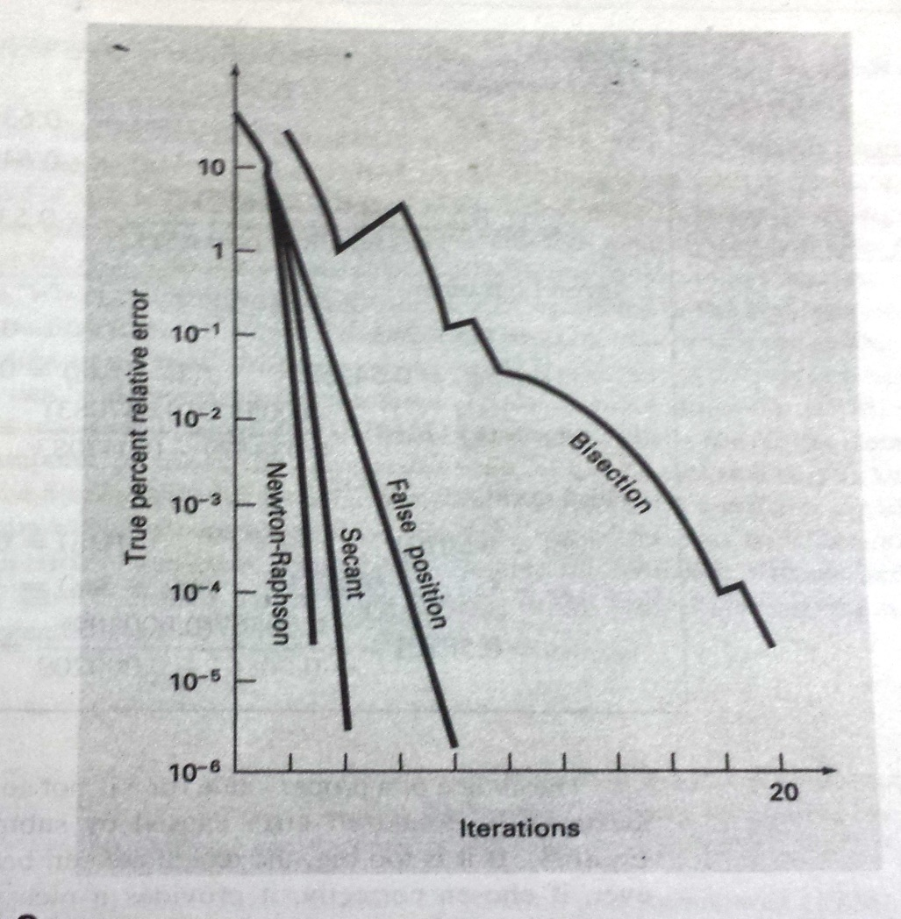
Convergence Comparison
Different methods have different convergence rate

Slide 10
References
Numerical Methods by E Balagurusamy

